Slide 1
Meeting #3 Slides
January 17, 2017

Slide 2
Tech Talk 3.1 – Fundamentals of Machine Learning
What is Machine Learning?
What is Machine Learning not?
Induction vs Deduction
What can you do with Machine Learning?
State of the Art
Computer Vision
http://cs.stanford.edu/people/karpathy/densecap/
Natural Language Processing
Automatic Translation
Voice Recognition
Approaching human understanding

Slide 3
3 Major Types of Machine Learning
Supervised Learning
Unsupervised Learning
Reinforcement Learning
Example based learning
Often requires a large training set
Can be expensive to acquire
Performance evaluation is straightforward
Two major categories
Classification – target variable is categorical
Regression – target variable is continuous
Examples: Non-linear regression, classification trees, neural networks,
Support vector machines
Requires no examples
Finds structure in the data
Examples: clustering, Principal Component Analysis, Independent Component Analysis
Reward based learning
Used in heavily in robotics and nowhere else.
Sort of like optimization

Slide 4
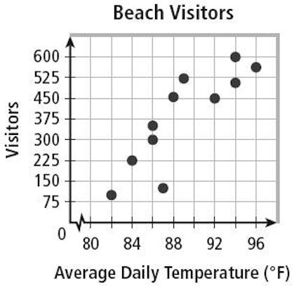
Supervised Learning
Training Phase
[ 2 ]
[ 4 ]
[ 6 ]
[ 8 ]
[ 10 ]
[ 1 ]
[ 2 ]
[ 3 ]
[ 4 ]
[ 5 ]
Linear Regression
Feature Vector
Machine Learning Algorithm
Target Variable
Performance
Metrics
Testing Phase
Linear Regression
Sum of Squared Error
[2.5]
[?]

Slide 5
Machine Learning Resources
Podcasts
http://dataskeptic.com/podcast
http://www.thetalkingmachines.com/blog/
Blogs
http://www.r2d3.us/visual-intro-to-machine-learning-part-1/
Courseware
Andrew Ng’s Standford Machine Learning Course
https://www.youtube.com/view_play_list?p=A89DCFA6ADACE599

